Slide 1

Capstone Project – Applied Data Science | Coursera

Slide 2
Introduction/Business Problem
Problem Description
A friend will be moving to a different city Bangalore, India from her home city of New Delhi, India for a job change.
She wants to find a neighborhood to stay in the new city which is the most like her home neighborhood.
Problem Background
I think this is an interesting problem to solve using Data Science as many people move between cities for various reasons such as job change, studies etc.
Doing this kind of analysis will give them a more familiar/similar environment in which they can adjust to their new home more easily.

Slide 3
Target Audience
Target Audience
People moving to a new city
Property rental websites
Real estate agents

Slide 4
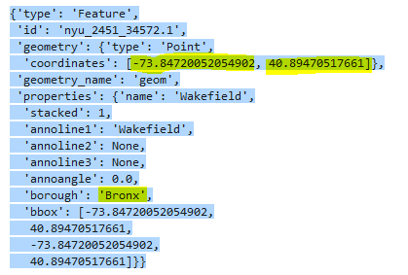
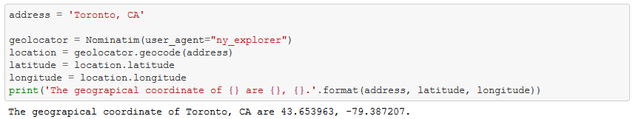
Data
Wikipedia
Delhi neighborhoods
https://en.wikipedia.org/wiki/Neighbourhoods_of_Delhi
Bangalore neighborhoods
https://en.wikipedia.org/wiki/List_of_neighbourhoods_in_Bangalore

Slide 5
Methodology
Get co-ordinates of home neighborhood i.e. Vasant Kunj, Delhi using GeoCoder.
Get co-ordinates of away neighborhoods in Bangalore using GeoCoder.
Verify co-ordinates from Wikipedia https://en.wikipedia.org/wiki/List_of_neighbourhoods_in_Bangalore
Clean co-ordinates for neighborhoods
e.g. Koramangala and Electronic City
Get details of venues in the neighborhoods using FourSquare API
Convert categorical values by one-hot encoding
Use K-Means to cluster the neighborhoods by similarity.
Plot the neighborhoods on Folium map
Find if there are away neighborhoods in the same cluster as the home neighborhood.

Slide 6
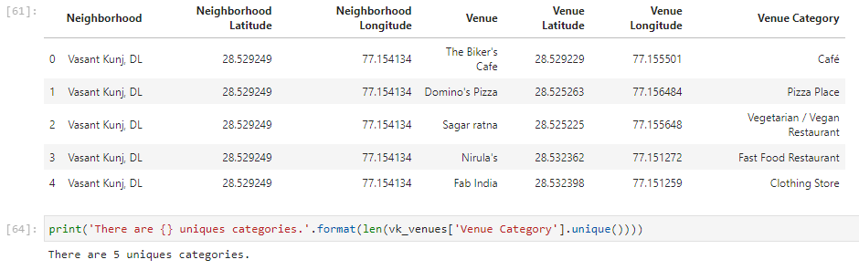
Results
The home neighborhood of Vasant Kunj did not match with any away neighborhood in Bangalore as suggested by the K-Means algorithm.
Home neighborhood of Vasant Kunj is not very diverse with only 5 unique venue categories.

Slide 7

Away neighborhoods in Bangalore Vasant Kunj are far more diverse with 71 unique venue categories.
Within Bangalore 5/10 neighborhoods fall in the same cluster with Restaurants and Cafes being a significant percentage.
The presence of pubs and drinking areas in Bangalore seems to skew the results away from Vasant Kunj.

Slide 8
Discussion
The user seems to have selected neighborhoods in Bangalore which are more non-residential localities as compared to her home neighborhood of Vasant Kunj which is a typical residential society in Delhi
The user needs to broaden her search in Bangalore and select more residential neighborhoods there if she wants to find a similar environment as in her home neighborhood.

Slide 10
Conclusion
The user seems to have selected neighborhoods in Bangalore which are more non-residential localities as compared to her home neighborhood of Vasant Kunj which is a typical residential society in Delhi
The user needs to broaden her search in Bangalore and select more residential neighborhoods there if she wants to find a similar environment as in her home neighborhood.

Slide 11
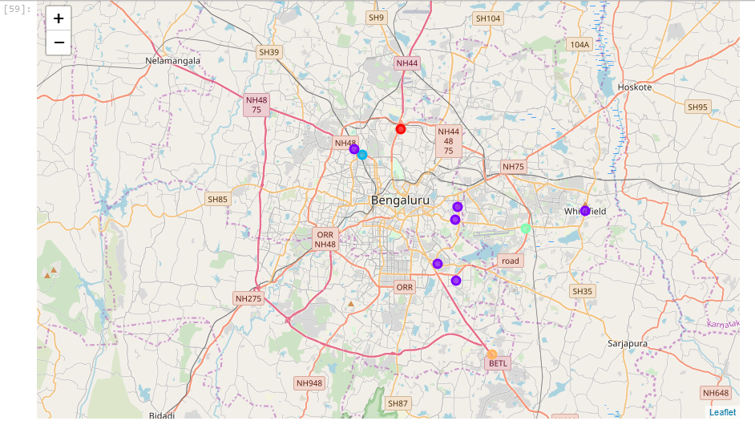

Slide 12
Thank You !

